Slide 1
Importance of Computer in Chemical Industries
Taslima Ferdaus Shuva
Sr. Lecturer, Dept of CSE

Slide 2
Area Covered
Uses of Computer in chemical industries
● DCS (distributed control system)
Fertilizer
Water Treatment
Chemical Plant
● Chromatography

Slide 3
Importance of Computer in chemical industries
Computer-Aided Chemical Engineering is being done since 1950s to the present state in which virtually all chemical engineering is computer-aided. Computer-aids are used at every stage from deciding what chemical species to make, through the conceptual design of the processes, the detailed design, the on-line control, optimization and up to the decommissioning. Computer-aids are important for assessing and minimizing environmental impacts and hazards.

Slide 4
There are several areas where Computerized systems are being used in Chemical Industries. Some of them are:
DCS (distributed control system)
○ Fertilizer
○ Water Treatment
○ Chemical Plant
Some others areas are :

Slide 5
Chemical plants
Petrochemical (oil) and refineries
Pulp and paper mills (see also: quality control system QCS)
Boiler controls and power plant systems
Nuclear power plants
Environmental control systems
Water management systems
Water treatment plants
Sewage treatment plants
Food and food processing
Agrochemical and fertilizer
Metal and mines
Automobile manufacturing
Metallurgical process plants
Pharmaceutical manufacturing
Sugar refining plants
Agriculture applications

Slide 6
DCS (distributed control system)
Distributed control systems (DCSs) are computer-software packages communicating with control hardware and providing a centralized human–machine interface (HMI) for controlled equipment.
It is a central computer that autonomously coordinates the many subsystems (such as sensors and controllers) located around a plant in real-time.
DCS are particularly important for controlling complex processes or for large continuous manufacturing plants where top-down control and coordination is vital for efficiency.

Slide 7
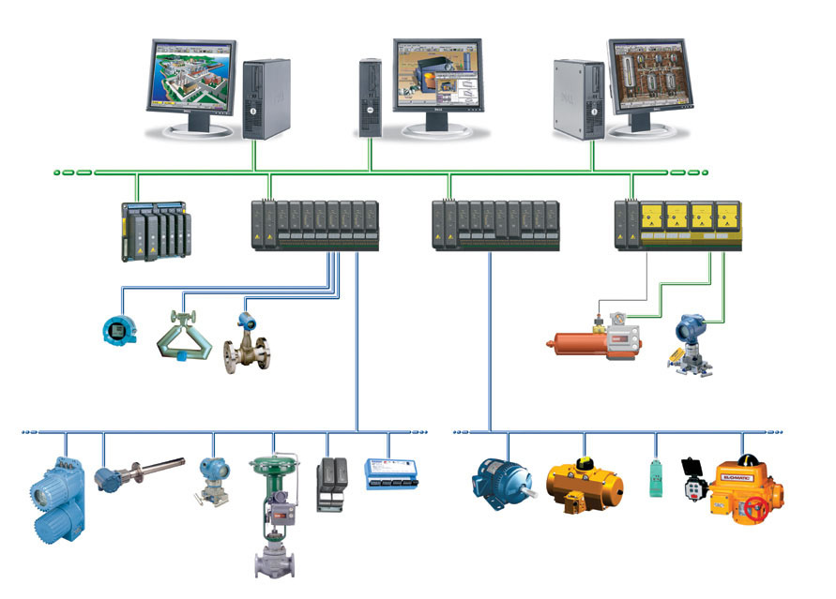
DCS (distributed control system)

Slide 8
Reference link:
What is Distributed Control System (DCS)? (electricaltechnology.org)

Slide 9
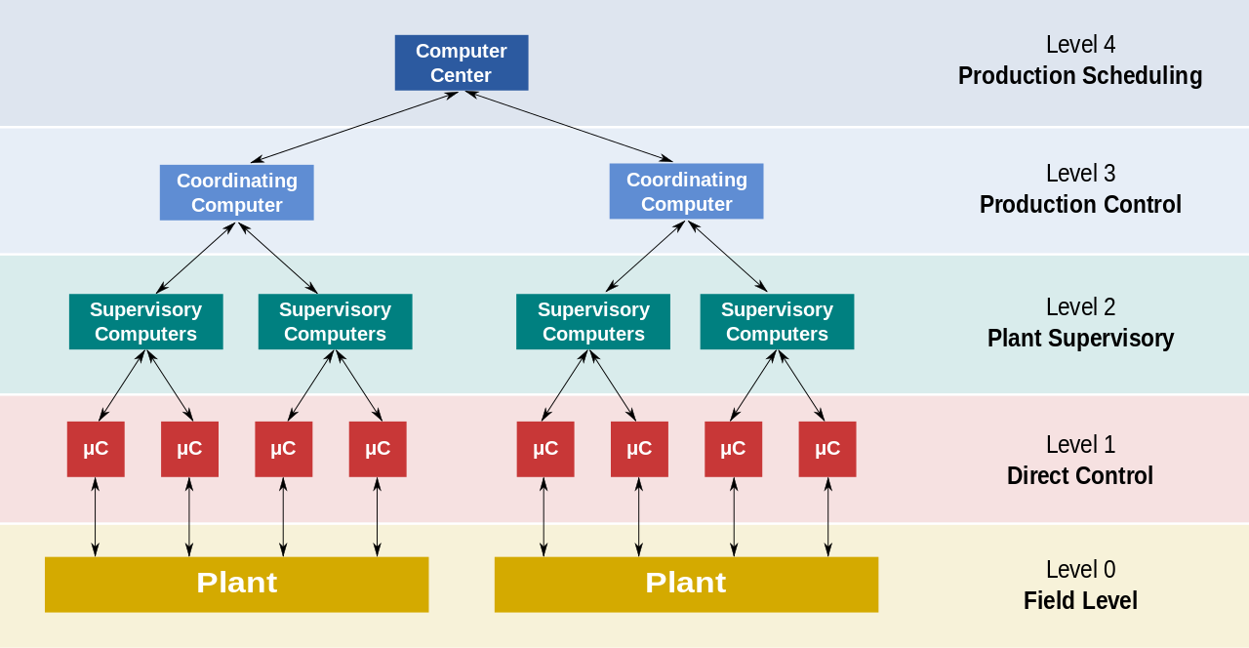
DCS (distributed control system)

Slide 10
Level 0 contains the field devices such as flow and temperature sensors, and final control elements, such as control valves
Level 1 contains the industrialised Input/Output (I/O) modules, and their associated distributed electronic processors.
Level 2 contains the supervisory computers, which collect information from processor nodes on the system, and provide the operator control screens.
Level 3 is the production control level, which does not directly control the process, but is concerned with monitoring production and monitoring targets
Level 4 is the production scheduling level.

Slide 11
Chromatography
Chromatography is a process for separating components of a mixture
Now a days computer aided systems are being used for chromatography. Chromatography is used to separate a mixture of sample causing them to separate. Using a computer to analyze the time taken for a compound to be detected, one can know what is the compound. This can be used for detecting unknown mixture found in crime scene, mapping DNA (you can google “DNA chromatography), and so on.

Slide 12
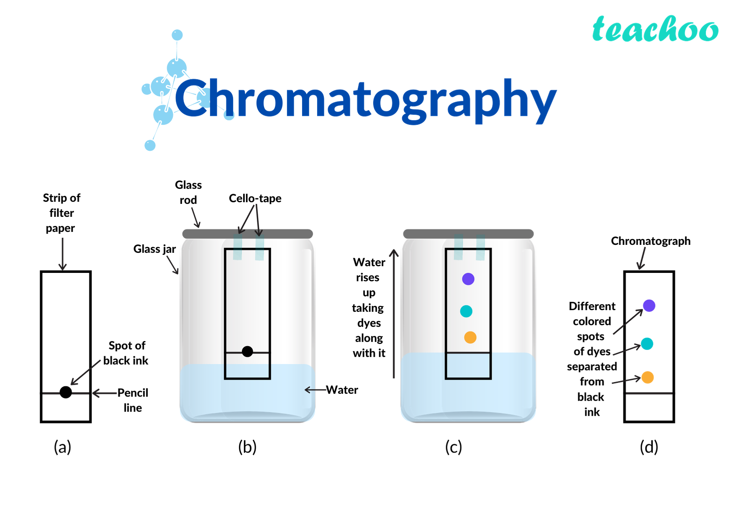

Slide 13
Reference link
Separating a Mixture Using Chromatography - Bing video

Slide 14
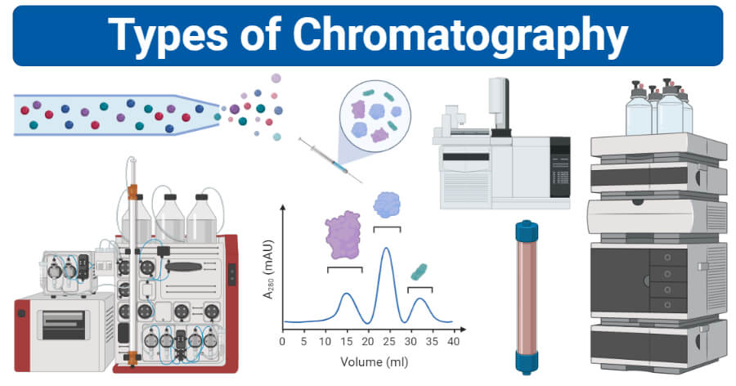

Slide 15
Reference link
14 Types of Chromatography (Definition, Principle, Steps, Uses) (microbenotes.com)

Slide 16
Uses of Chromatography
Let's start with some areas where it is used more often. (Not limited to)
Pharmaceutical industry: In this field,(Includes Cosmetics and Herbal products too) it is mainly used to assertion purity of drugs. Identify impurities and develop chromatographic methods to quantify impurities.
Food and beverage industry: In this industry, it is used to majorly identify contaminants like pesticides content in beverages or heavy metal contents in water of food stuffs.
Forensic Labs: Here, chromatography is used to determine which fluids and compounds are present in human body after death or analyze blood samples to know whether he was poisoned to death etc.
Diagnostic Labs: In this Labs, we determine amount of drug present in blood, urine samples etc. You would be aware of dope tests where players are tested for banned steroids.

Slide 17
“Tell me and I forget, teach me and I may remember, involve me and I learn.” ― Benjamin Franklin

